Slide 1
Computer Organization and Architecture
LECTURE NO. 3
FACULTY OF COMPUTING
RIPHAH INTERNATIONAL UNIVERSITY

Slide 2
Today….
Basic Computer Organization
Computer Components
IA-32 Registers
Intel Microprocessors

Slide 3
Architecture & Organization 1
Architecture is those attributes visible to the programmer
  Instruction set, number of bits used to represent data types, I/O mechanisms, addressing techniques.
  e.g. Is there a multiply instruction?
Organization is how features are implemented
  Control signals, interfaces, memory technology.
  e.g. Is there a hardware multiply unit or is it done by repeated addition?
Notes:
Architectures visible to machine language programmer
Organization refers to operational units and how they are implemented to realize a particular architecture.

Slide 4
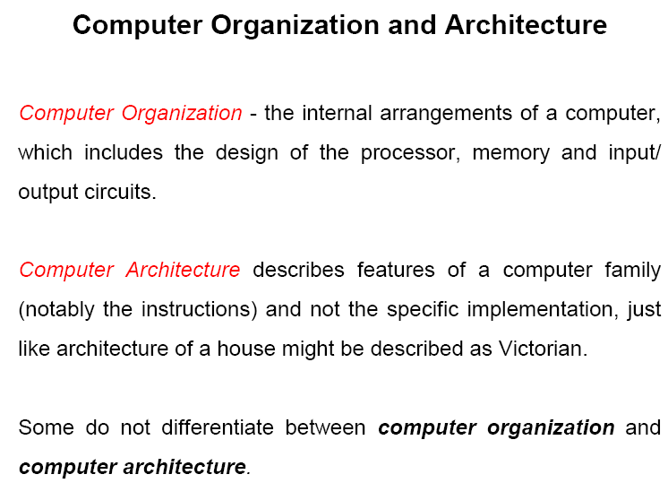

Slide 5
Architecture & Organization 2
All Intel x86 family share the same basic architecture
The IBM System/370 family share the same basic architecture
This gives code compatibility
  At least backwards
Organization differs between different versions

Slide 6
Structure & Function
Structure is the way in which components relate to each other
Function is the operation of individual components as part of the structure

Slide 7

Basic Functions of Computer
All computer functions are:
  Data processing
  Data storage
  Data movement
  Control

Slide 8
Structure
data bus
registers
The Computer
  Main memory
    Stores data
  CPU
    Controls the operation of the computer and performs its data processing functions.
  I/O
    Moves data between the computer and its external environment
  System interconnection
    Provides for communication among CPU, main memory, and I/O
Processor
(CPU)
Memory
I/O
I/O
Device
Device
#1
#2
ALU
CU
clock
control bus
address bus
Notes:
How is the computer structured to perform these functions

Slide 9
Structure - Top Level
Peripherals
Computer
Central
Processing
Unit
Main
Memory
Computer
Systems
Interconnection
Input
Output
Communication
lines

Slide 10
Structure - The CPU
CPU
Computer
Arithmetic
and
Logic Unit
I/O
Registers
System
Bus
CPU
Internal CPU
Interconnection
Memory
Control
Unit

Slide 11
Structure - The Control Unit
Control Unit
CPU
ALU
Sequencing
Logic
Internal
Bus
Control
Unit
Control Unit
Registers and
Decoders
Registers
Control
Memory

Slide 12
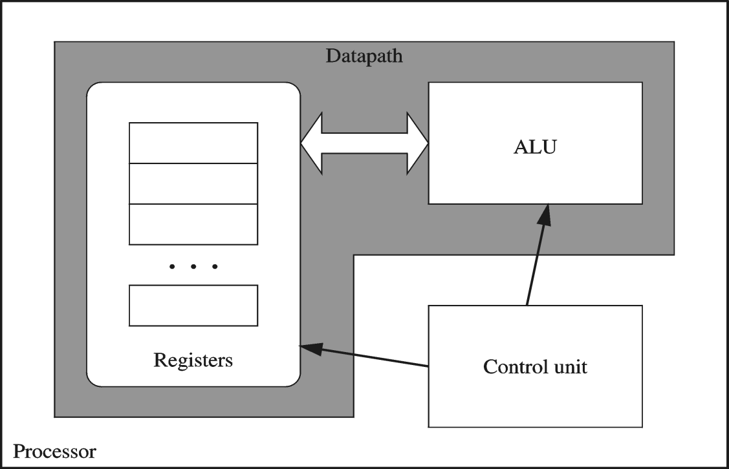
Processor
Processor consists of
  Datapath
    ALU
    Registers
  Control unit
ALU
  Performs arithmetic
  and logic instructions
Control unit (CU)
  Generates the control signals required to execute instructions
  Implementation varies from one processor to another
Notes:
Datapath = wires to transmit data

Slide 13
Clock
Synchronizes Processor and Bus operations
Clock cycle = Clock period = 1 / Clock rate
Clock rate = Clock frequency = Cycles per second
  1 Hz = 1 cycle/sec 1 KHz = 10³ cycles/sec
  1 MHz = 10⁶ cycles/sec 1 GHz = 10⁹ cycles/sec
  2 GHz clock has a cycle time = 1/(2×10⁹) = 0.5 nanosecond (ns)
Clock cycles measure the execution of instructions
Cycle 1
Cycle 2
Cycle 3
Notes:
An increase in clock rate means that individual operations are executed more rapidly.
Older computers could execute one instruction per cycle and newer can execute multiple.
All components perform operation when clock is high(1). And clock goes high million times a second.
CPU speeds are higher than other components so it takes system clock value and multiplies it with a factor for use.

Slide 14
Memory
Ordered sequence of bytes
  The sequence number is called the memory address
Byte addressable memory
  Each byte has a unique address
  Supported by almost all processors
Physical address space
  Number of addressable bytes
  Pentium has a 32-bit address bus
    Physical address space = 4GB = 2³² = 4000 000 000 bytes
  Itanium with a 64-bit address bus can support
    Up to 2⁶⁴ bytes of physical address space
Notes:
Determined by address bus width

Slide 15
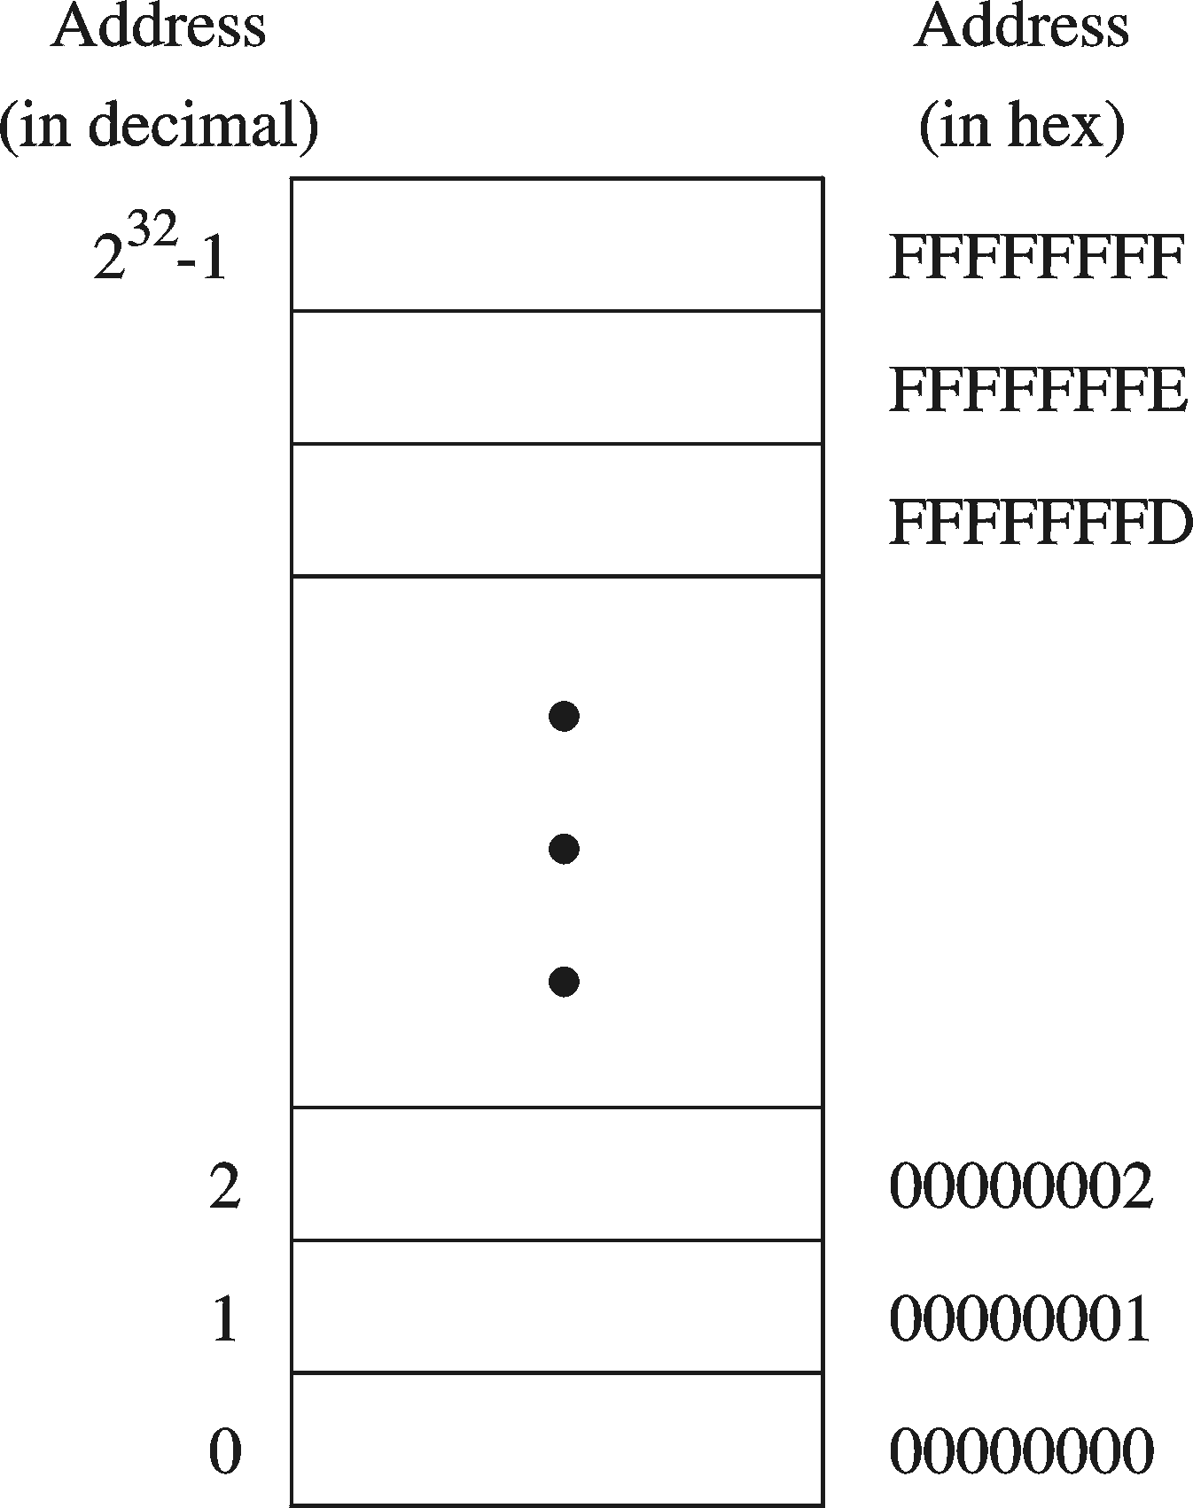
Address Space
Address Space is the set of memory locations (bytes) that can be addressed

Slide 16
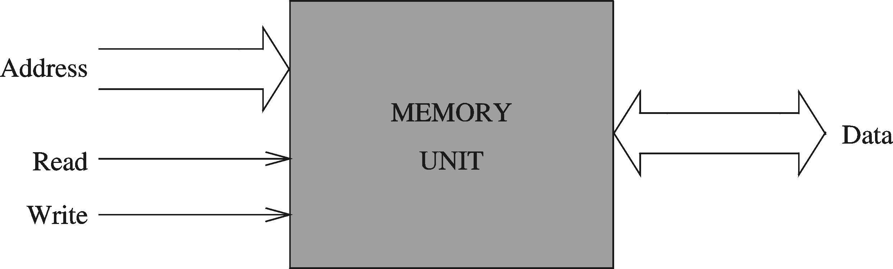
Memory Unit
Address Bus
  Address is placed on the address bus
  Address of location to be read/written
Data Bus
  Data is placed on the data bus
Two Control Signals
  Read
  Write
  Control whether memory should be read or written
Notes:
How to fetch data from memory

Slide 17
Memory Read and Write Cycles
Read cycle
  1. Processor places address on the address bus
  2. Processor asserts the memory read control signal
  3. Processor waits for memory to place the data on the data bus
  4. Processor reads the data from the data bus
  5. Processor drops the memory read signal
Write cycle
  1. Processor places address on the address bus
  2. Processor asserts the memory write control signal
  3. Processor places the data on the data bus
  4. Wait for memory to store the data (wait states for slow memory)
  5. Processor drops the memory write signal

Slide 18
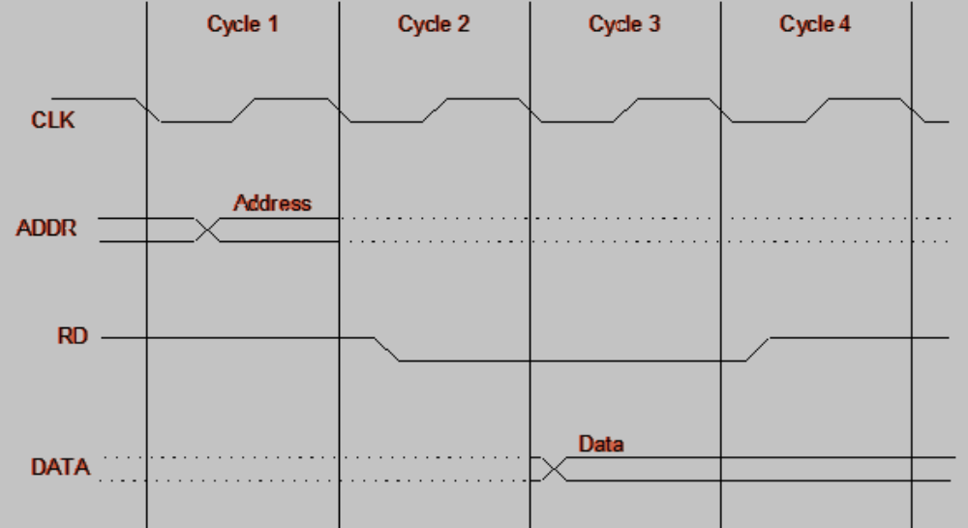
Reading from Memory
Multiple clock cycles are required. Why?
Memory responds much slower than the CPU
  Address is placed on address bus
  Read Line (RD) goes low, indicating that processor wants to read
  CPU waits (one or more cycles) for memory to respond
  Read Line (RD) goes high, indicating that data is on the data bus

Slide 19
Memory Devices
ROM = Read-Only Memory
  Stores information permanently (non-volatile)
  Used to store the information required to startup the computer
  Many types: ROM, EPROM, EEPROM, and FLASH
  FLASH memory can be erased electrically in blocks
RAM = Random Access Memory
  Volatile memory: data is lost when device is powered off
  Dynamic RAM (DRAM)
    Inexpensive, used for main memory, must be refreshed constantly
  Static RAM (SRAM)
    Expensive, used for cache memory, faster access, no refresh
Notes:
EPROM= whole chip erased using UV light
EEPROM= byte by byte erasure using electric charge
FLASH= block by block erasure using electric charge
DRAM:
Presence or absence of charge in capacitors is interpreted as 1 or 0
Since charge dissipates so periodic refreshing of charge required.
SRAM:
Uses flip-flops

Slide 20
Memory Hierarchy
Registers
  Fastest storage elements, stores most frequently used data
  General-purpose registers: accessible to the programmer
  Special-purpose registers: used internally by the microprocessor
Cache Memory (SRAM)
  Fast SRAM that stores recently used instructions and data
  Recent processors have 2 levels
Main Memory (DRAM)
Disk Storage
  Permanent magnetic storage for files
registers
cache memory
higher speed, smaller size
lower cost per byte
main memory
disk storage

Slide 21
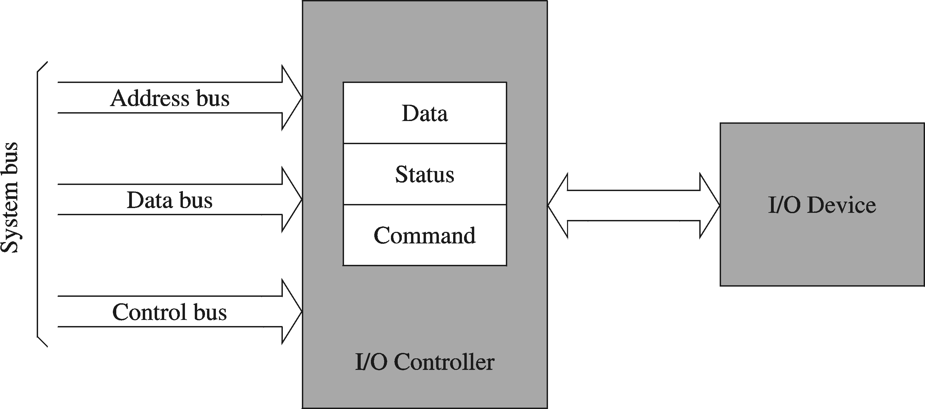
I/O Controllers
I/O devices are interfaced via an I/O controller
  I/O controller uses the system bus to communicate with processor
  I/O controller takes care of low-level operation details
Notes:
Exchange of data b/w processor and devices is done by IO controller.
I/O controller can send interrupts to the processor.

Slide 22
NEXT….
Basic Computer Organization
Computer Components
IA-32 Registers
Intel Microprocessors

Slide 23
Basic Program Execution Registers
Registers are high speed memory inside the CPU
  Eight 32-bit general-purpose registers
  Six 16-bit segment registers
  Processor Status Flags (EFLAGS) and Instruction Pointer (EIP)
32-bit General-Purpose Registers
EAX
EBP
EBX
ESP
ECX
ESI
EDX
EDI
16-bit Segment Registers
EFLAGS
CS
ES
SS
FS
EIP
DS
GS

Slide 24
General-Purpose Registers
Used primarily for arithmetic and data movement
  mov eax, 10 move constant 10 into register eax
Specialized uses of Registers
  EAX – Accumulator register
    Automatically used by multiplication and division instructions
  ECX – Counter register
    Automatically used by LOOP instructions
  ESP – Stack Pointer register
    Used by PUSH and POP instructions, points to top of stack
  ESI and EDI – Source Index and Destination Index register
    Used by string instructions
  EBP – Base Pointer register
    Used to reference parameters and local variables on the stack

Slide 25



Accessing Parts of Registers
EAX, EBX, ECX, and EDX are 32-bit Extended registers
  Programmers can access their 16-bit and 8-bit parts
  Lower 16-bit of EAX is named AX
  AX is further divided into
    AL = lower 8 bits
    AH = upper 8 bits
ESI, EDI, EBP, ESP have only
16-bit names for lower half

Slide 26
Special-Purpose & Segment Registers
EIP = Extended Instruction Pointer
  Contains address of next instruction to be executed
EFLAGS = Extended Flags Register
  Contains status and control flags
  Each flag is a single binary bit
  Stores condition flags that reflect the result of arithmetic and logical operations (e.g., Zero Flag, Carry Flag, Sign Flag), and control flags that modify CPU behavior (e.g., Interrupt Flag, Direction Flag).
Status Flags
  Status of arithmetic and logical operations
Control and System flags
  Control the CPU operation
Programs can set and clear individual bits in the EFLAGS register
Notes:
CS: where executable code of program is located. Read only
DS: default data segment for memory accesses

Slide 27
Status Flags
Carry Flag
  Set when unsigned arithmetic result is out of range
Overflow Flag
  Set when signed arithmetic result is out of range
Sign Flag
  Copy of sign bit, set when result is negative
Zero Flag
  Set when result is zero
Auxiliary Carry Flag
  Set when there is a carry from bit 3 to bit 4
Parity Flag
  Set when parity is even
  Least-significant byte in result contains even number of 1’s

Slide 28
Control Flags
Interrupt Flag (IF):
Purpose: Controls the handling of hardware interrupts. If set, the CPU can respond to interrupts; if cleared, the CPU ignores hardware interrupts.
Usage: Important for enabling or disabling the handling of external events like hardware device notifications.
Direction Flag (DF):
Purpose: Controls the direction in which string operations are performed. When set, string operations (like MOVS or LODS) decrement the index registers (ESI/EDI). When cleared, they increment.
Usage: Used for processing strings of data either forward (incrementing) or backward (decrementing).

Slide 29
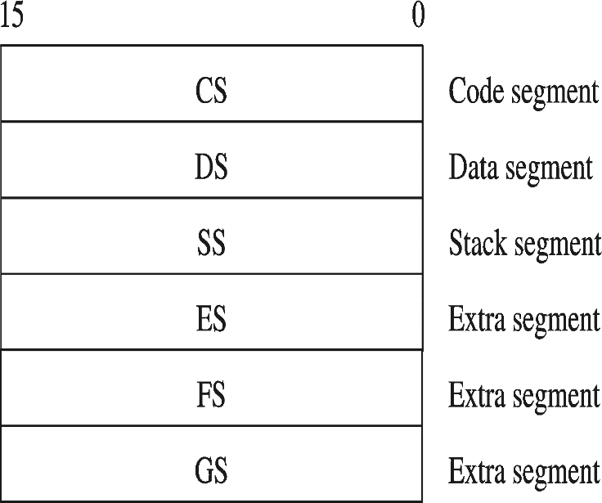
Segment Registers (CS, DS, SS, ES, FS, GS):
Usage: Hold the base addresses of different memory segments:
  Support segmented memory
  Six segments accessible at a time
  CS (Code Segment): Points to the segment where the current program code is located.
  DS (Data Segment): Points to the segment containing data and variables.
  SS (Stack Segment): Points to the segment used by the stack.
  ES (Extra Segment), FS, GS: Provide additional segments for specialized data or extended addressing.

Slide 30

Floating-Point, MMX, XMM Registers
Floating-point unit performs high speed FP operations
Eight 80-bit floating-point data registers
  ST(0), ST(1), . . . , ST(7)
  Arranged as a stack
  Used for floating-point arithmetic
Eight 64-bit MMX registers
  Used with MMX instructions
Eight 128-bit XMM registers
  Used with SSE instructions
Notes:
MMX (multimedia extensions) technology processes video, audio and graphics efficiently
MMX instructions are set of highly optimized instructions for multimedia tasks
SSE ( streaming SIMD instructions)
SIMD: single-instruction-multiple-data

Slide 31
NEXT….
Basic Computer Organization
Computer Components
IA-32 Registers
Intel Microprocessors

Slide 32
Intel Microprocessors
Intel introduced the 8086 microprocessor in 1979
8086, 8087, 8088, and 80186 processors
  16-bit processors with 16-bit registers
  16-bit data bus and 20-bit address bus
    Physical address space = 2²⁰ bytes = 1 MB
  8087 Floating-Point co-processor
  Uses segmentation and real-address mode to address memory
    Each segment can address 2¹⁶ bytes = 64 KB
  8088 is a less expensive version of 8086
    Uses an 8-bit data bus
  80186 is a faster version of 8086

Slide 33
Intel 80286 and 80386 Processors
80286 was introduced in 1982
  24-bit address bus ⇒ 2²⁴ bytes = 16 MB address space
  Introduced protected mode
    Segmentation in protected mode is different from the real mode
80386 was introduced in 1985
  First 32-bit processor with 32-bit general-purpose registers
  First processor to define the IA-32 architecture
  32-bit data bus and 32-bit address bus
  2³² bytes ⇒ 4 GB address space
  Introduced paging, virtual memory, and the flat memory model
    Segmentation can be turned off

Slide 34
Intel 80486 and Pentium Processors
80486 was introduced 1989
  Improved version of Intel 80386
  On-chip Floating-Point unit (DX versions)
  On-chip unified Instruction/Data Cache (8 KB)
  Uses Pipelining: can execute up to 1 instruction per clock cycle
Pentium (80586) was introduced in 1993
  Wider 64-bit data bus, but address bus is still 32 bits
  Two execution pipelines: U-pipe and V-pipe
    Superscalar performance: can execute 2 instructions per clock cycle
  Separate 8 KB instruction and 8 KB data caches
  MMX instructions (later models) for multimedia applications

Slide 35
Intel P6 Processor Family
P6 Processor Family: Pentium Pro, Pentium II and III
Pentium Pro was introduced in 1995
  Three-way superscalar: can execute 3 instructions per clock cycle
  36-bit address bus ⇒ up to 64 GB of physical address space
  Introduced dynamic execution
    Out-of-order and speculative execution
  Integrates a 256 KB second level L2 cache on-chip
Pentium II was introduced in 1997
  Added MMX instructions (already introduced on Pentium MMX)
Pentium III was introduced in 1999
  Added SSE instructions and eight new 128-bit XMM registers

Slide 36
Pentium 4 and Xeon Family
Pentium 4 is a seventh-generation x86 architecture
  Introduced in 2000
  New micro-architecture design called Intel Netburst
  Very deep instruction pipeline, scaling to very high frequencies
  Introduced the SSE2 instruction set (extension to SSE)
    Tuned for multimedia and operating on the 128-bit XMM registers
In 2002, Intel introduced Hyper-Threading technology
  Allowed 2 programs to run simultaneously, sharing resources
Xeon is Intel's name for its server-class microprocessors
  Xeon chips generally have more cache
  Support larger multiprocessor configurations

Slide 37
Pentium-M and EM64T
Pentium M (Mobile) was introduced in 2003
  Designed for low-power laptop computers
  Modified version of Pentium III, optimized for power efficiency
  Large second-level cache (2 MB on later models)
  Runs at lower clock than Pentium 4, but with better performance
Extended Memory 64-bit Technology (EM64T)
  Introduced in 2004
  64-bit superset of the IA-32 processor architecture
  64-bit general-purpose registers and integer support
  Number of general-purpose registers increased from 8 to 16
  64-bit pointers and flat virtual address space
  Large physical address space: up to 2⁴⁰ = 1 Terabytes

